Slide 1


World Health Organization Motor Milestones - WHO MM
Anna Mayhew

Slide 2
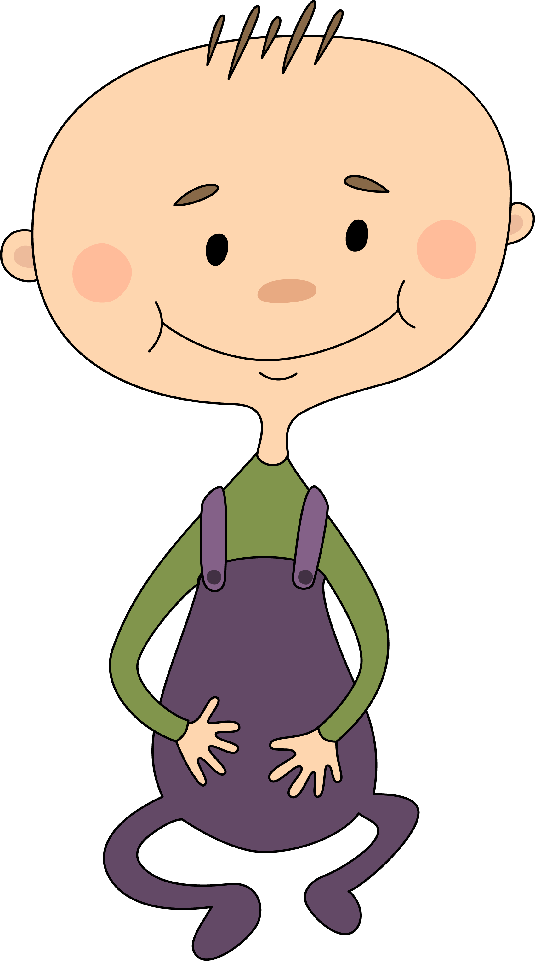
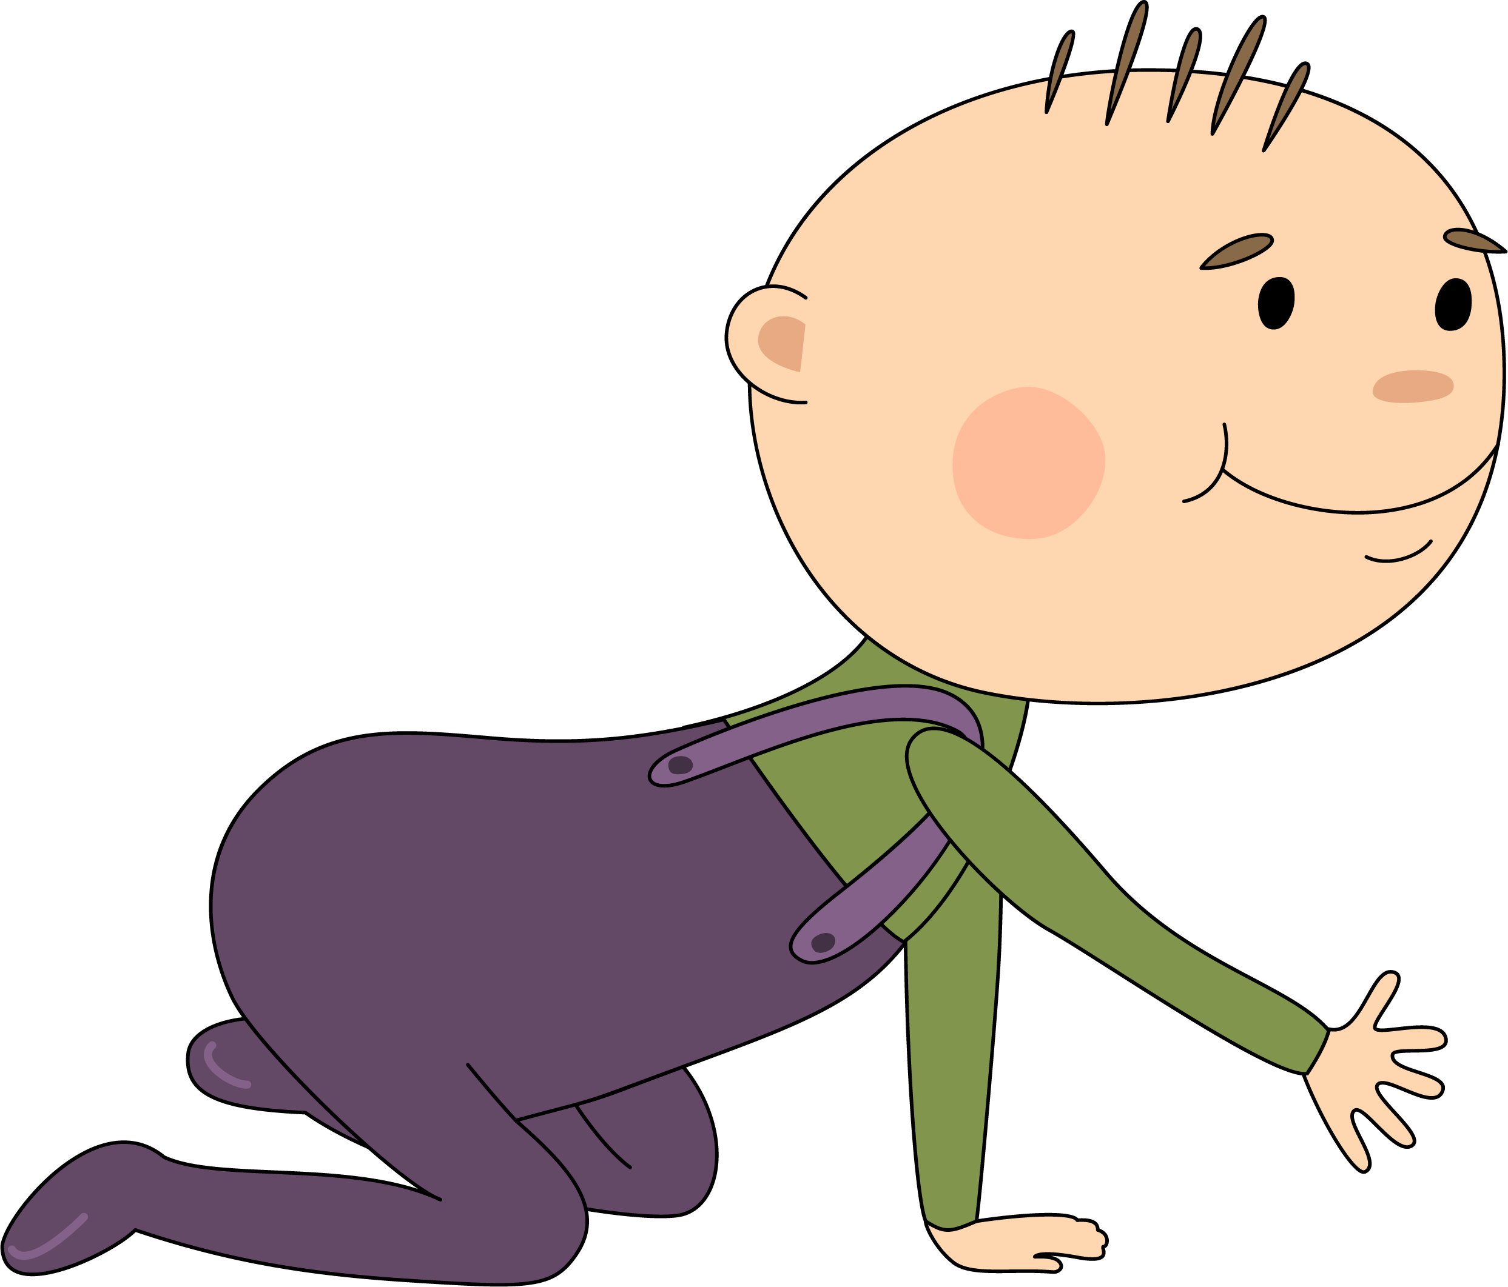
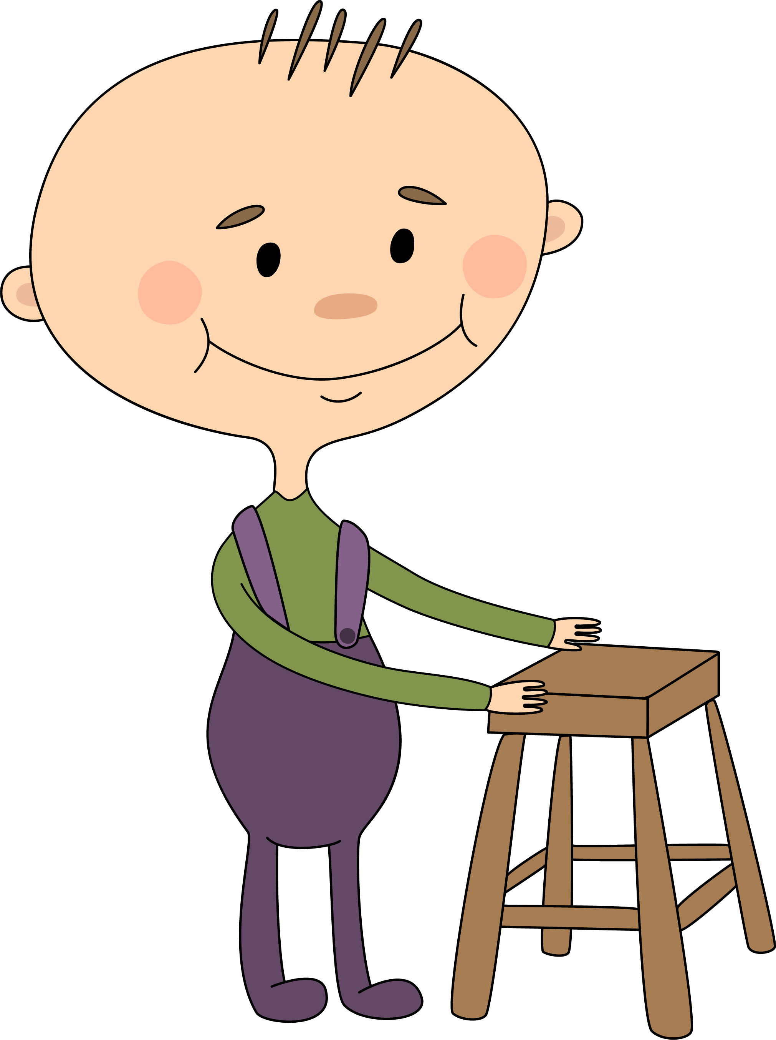
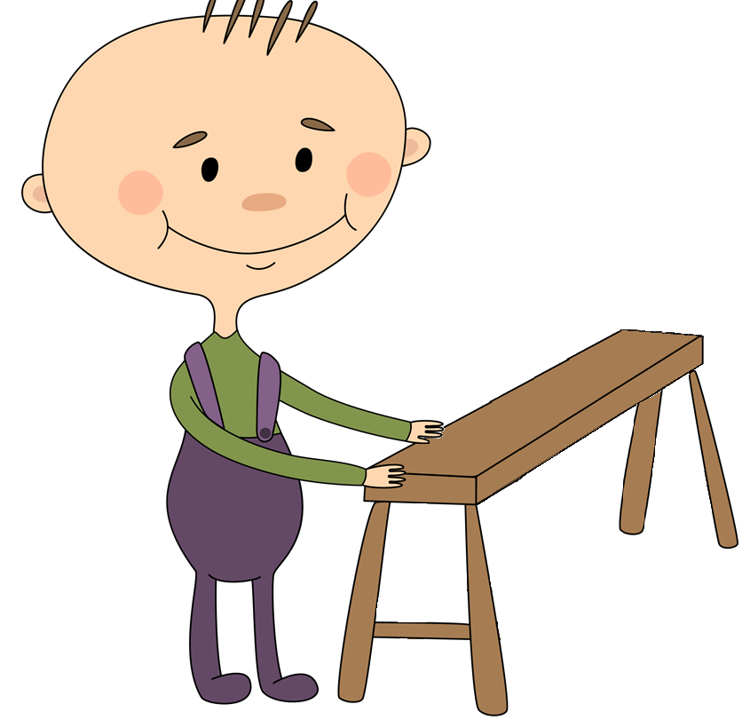
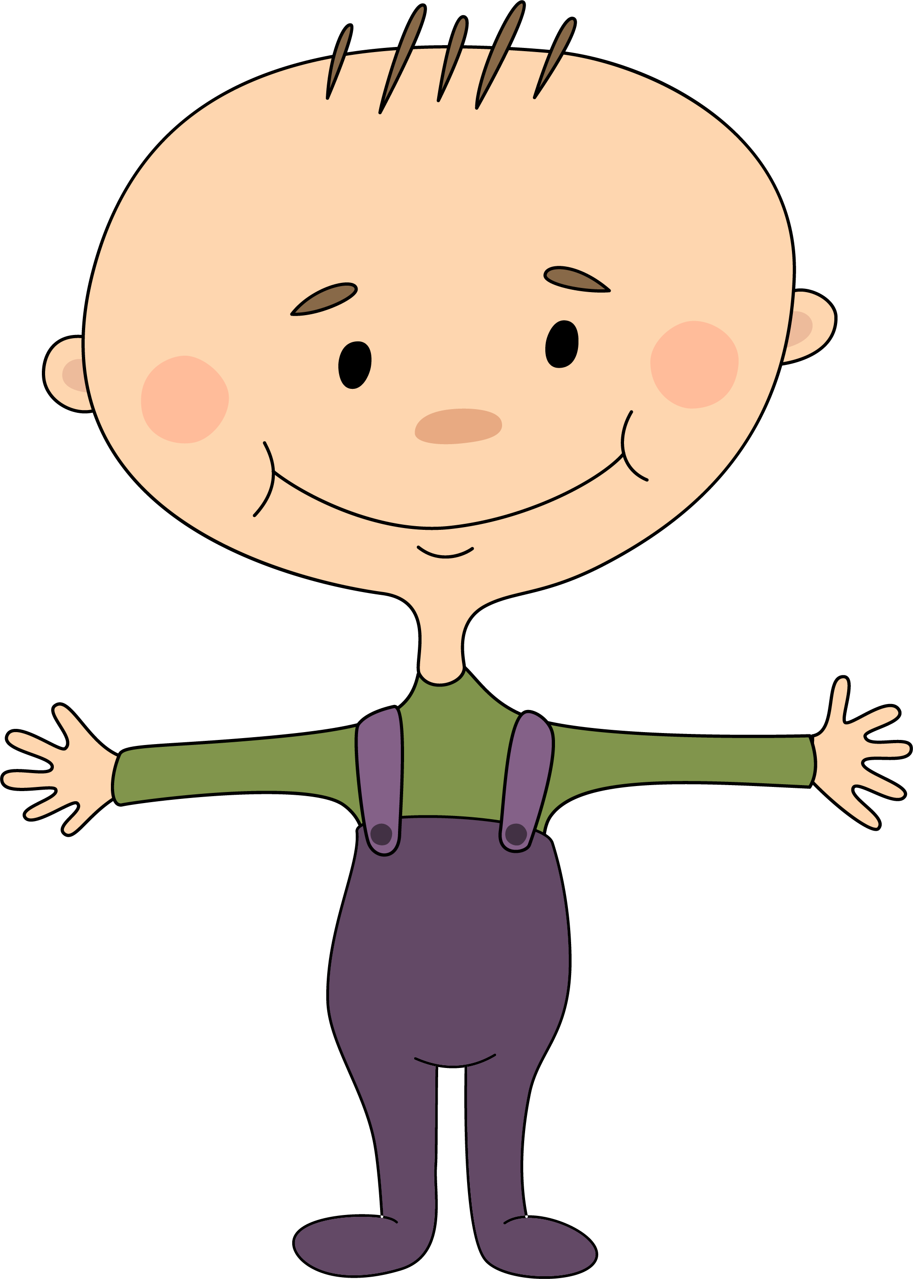
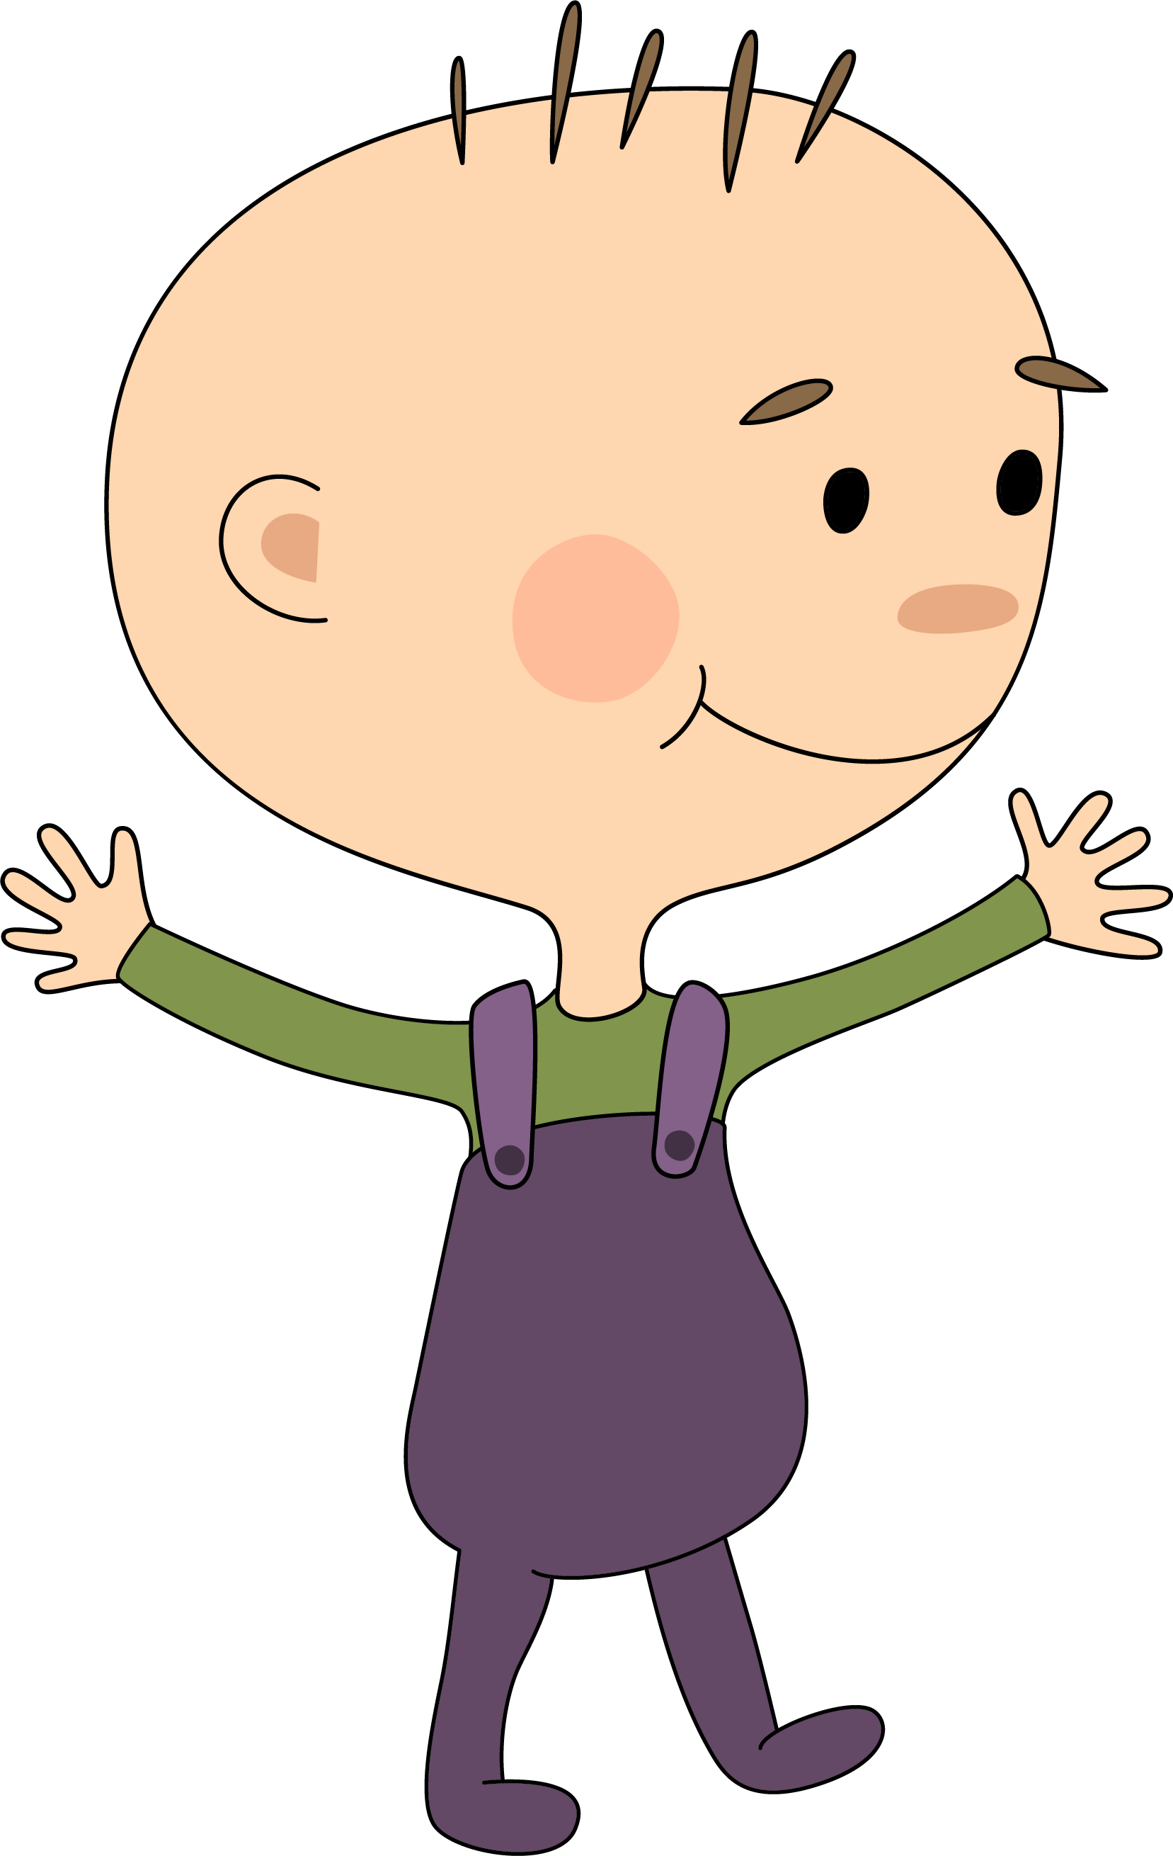
Overview of the 6 WHO motor milestones
1 | 2 | 3 | 4 | 5 | 6
Sitting without support | Hands-and-knees crawling | Standing with assistance | Walking with assistance | Standing alone | Walking alone
Wijnhoven TM, et al. Food Nutr Bull. 2004;25:S37-45.
Notes:
Royalty-free stock vector ID: 645127597

Slide 3
Normal windows of achievement for WHO milestones
Walking alone
Standing alone
Motor milestones
Walking with assistance
Hand-and-knees crawling
Standing with assistance
Assessed in 816 children in Ghana, India, Norway, Oman and USA
Sitting without support
3
4
5
6
7
8
9
10
11
12
13
14
15
16
17
18
19
20
21
Age in months
WHO Multicentre Growth Reference Study Group. Acta Paediatrica 2006; Suppl 450: 86-95.

Slide 4
Administration
Each milestones is marked as Achieved or Not Achieved
May be administered in conjunction with the RHS
RHS 1 = can score WHO item 1
RHS 16 = can score WHO items 3, 4
RHS 17 = can score WHO item 5
RHS 18 = can score WHO item 6
May be an extension of what is required to score on the RHS, so each item must be administered appropriately.
For example, as you attempt Item 1 – sit for 3 seconds. Extend time tested to see if they can score for Sitting item
RHS 12 = can score WHO item 2

Slide 5
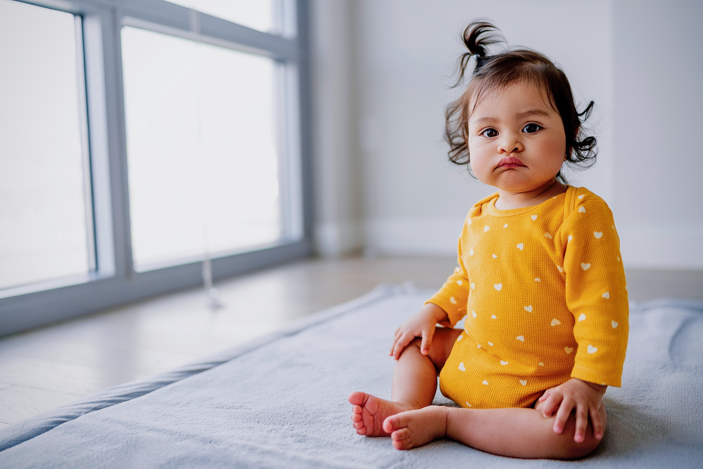
Observation
Best to undress and have child with no shoes or socks but not an absolute requirement in clinical / home situation
Can work with parents / carers to position and test the child

Slide 6
WHO Item 1: Sitting without support
Sits up straight with the head erect for at least 10 seconds. Does not use arms or hands to balance body or support position.
Corresponding RHS Item: 1

Slide 7
WHO Item 2: Hands and knees crawling
Alternately moves forward or backward on hands and knees. The stomach does not touch the supporting surface. There are continuous and consecutive movements at least 3 in a row.
Corresponding RHS Item: 12

Slide 8
WHO Item 3: Standing with assistance
Is in upright position on both feet. Holds onto a stable object with both hands without leaning on it. Body does not touch the stable object. Legs support most of the body weight. Stands with assistance for at least 10 seconds.
Corresponding RHS Item: 16

Slide 9
WHO Item 4: Walking with assistance
Is in upright position with the back straight. Makes sideways or forward steps by holding onto a stable object (e.g., furniture) with one or both hands. One leg moves forward while the other supports part of the body weight. Takes at least five steps in this manner.
Corresponding RHS Item: 16

Slide 10
WHO Item 5: Standing alone
Stands in upright position on both feet (not the toes) with back straight. The legs support 100% of the weight. There is no contact with a person or object. Stands alone for at least 10 seconds .
Corresponding RHS Item: 17

Slide 11
WHO Item 6: Walking alone
Takes at least 5 steps independently in upright position with the back straight. One leg moves forward while the other supports most of the body weight. There is no contact with a person or object.
Corresponding RHS Item: 18

Slide 12
WHO Developmental Milestones
Multicentre Growth Reference Study WHO Gross Motor Milestones (Wijnhoven et al, 2004)
*WHO DEVELOPMENTAL MILESTONES | Qualifier met:
W1. Sitting without support: Child sits upright with head erect for at least 10 seconds. Child does not use arms or hands to balance body or support position. | Y 🀆 N 🀆
W2. Hands and knees crawling: Child alternately moves forward or backward on hands and knees. The stomach does not touch the supporting surface. There are continuous and consecutive movement, at least 3 in a row. | Y 🀆 N 🀆
W3. Standing with Assistance: Child stands in upright position on both feet, holding onto a stable object (e.g. furniture) with both hands without leaning on it. The body does not touch the stable object, and the legs support most of the body weight. Child thus stands with assistance for at least 10 seconds. | Y 🀆 N 🀆
W4. Walking with Assistance: Child is in upright position with the back straight. Child makes sideways or forward steps by holding onto a stable object (e.g. furniture) with one or both hands. One leg moves forward while the other supports part of the body weight. Child takes at least 5 steps in this manner. | Y 🀆 N 🀆
W5. Standing Alone: Child stands in upright position on both feet (not the toes) with the back straight. The legs support 100% of the child’s weight. There is no contact with a person or object. Child stands alone for at least 10 seconds. | Y 🀆 N 🀆
W6. Walking Alone: Child takes at least 5 steps independently in upright position with the back straight. One leg moves forward while the other supports most of the body weight. There is no contact with the person or object. | Y 🀆 N 🀆
Total WHO Milestones Achieved: | / 6

Slide 13
Thank you

